Slide 1
The Assessment Continuum
Before, in, and after lecture
James (J.T.) Laverty
Michigan State University
April 16, 2012
Slides borrowed from:
Gerd Kortemeyer

Slide 2
What makes a good use of technology in education?
Must be integrated into the educational experience!
supporting the goals - not technology for technology sake
not scattered "technology highlights" - consistently applied - students know what to expect and what is expected
moving into the background - not wizz-bang or gimmicky
increasing effective time on task - make the students interact with the materials - do not waste student time
Giving effective and timely feedback to learners and instructors: assessment

Slide 3
Assessment
Assessment: Feedback to learners and instructors
Formative assessment:
  Students can keep track of their own learning
    Students do not fall behind
  Instructors keep track of their students’ learning
    can adapt the teaching to the learning
Summative assessment: exams
  Technology allows for frequent exams

Slide 4
Assessment
Pre-Class Questions
  Students being prepared for lecture
  Just-In-Time Teaching
In-Class Questions
  Clickers
Post-Class Questions
  Homework
  Online Discussions, Helprooms
  Exams
Does this even work?
How is this realistically possible?
  That’s where course and learning content management come in!
Lecture
?

Slide 5
Pre-Class Questions
Students being prepared for lecture
Just-In-Time Teaching

Slide 6
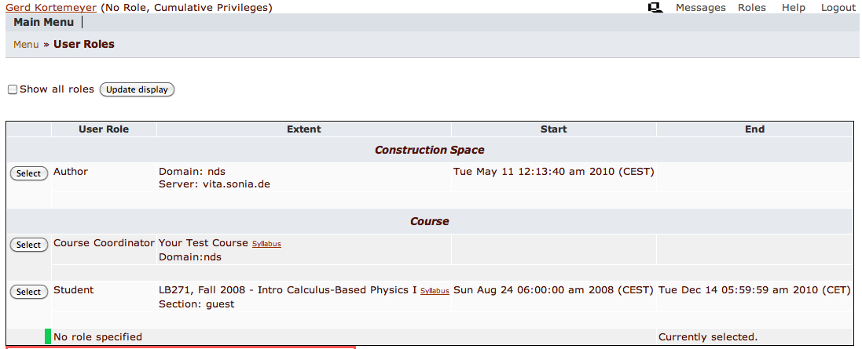
Pre-Class Questions

Slide 7
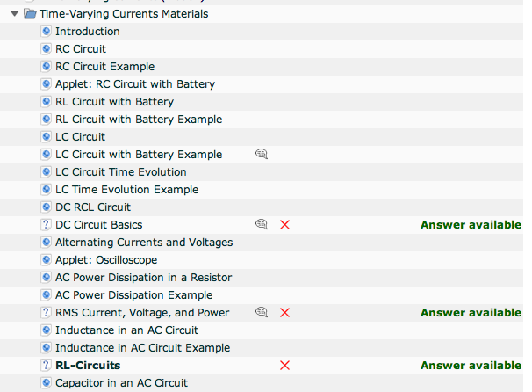
Pre-Class Questions
Easy questions embedded into content
Due before lecture

Slide 8
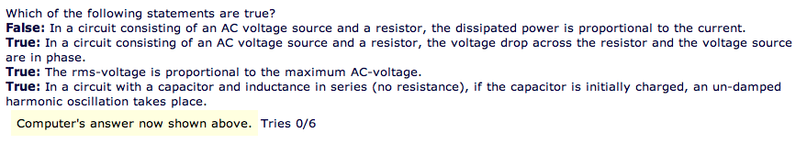
Pre-Class Questions
Make sure students read materials
Questions can be answered just based on the readings
Students come prepared

Slide 9
Just-In-Time
Adapt lecture to student difficulties
When I looked at your homework this morning, I saw that all of you have understood quantum field theory, but many of you still have problems with long division. So this morning, we will …

Slide 10
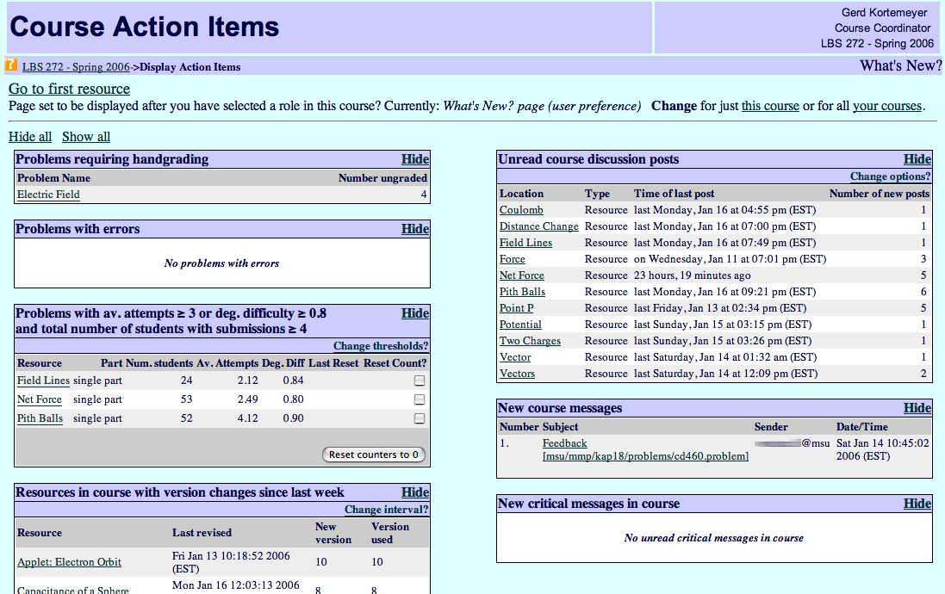
Just-In-Time
Discussions
Difficult problems

Slide 11
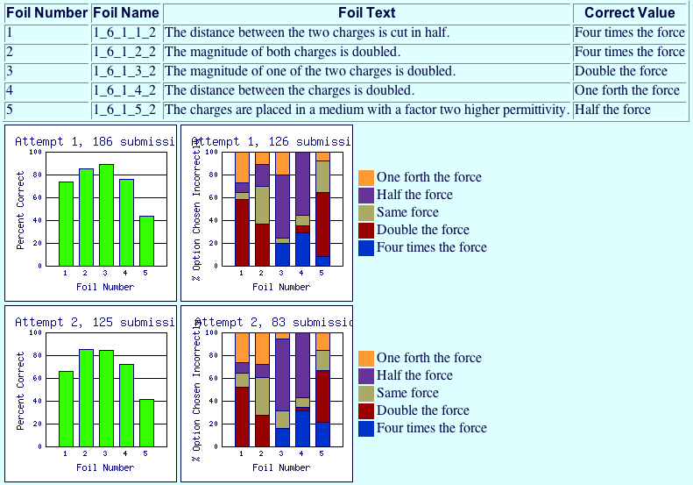
Just-In-Time

Slide 12
In-Class Questions
Clickers

Slide 13
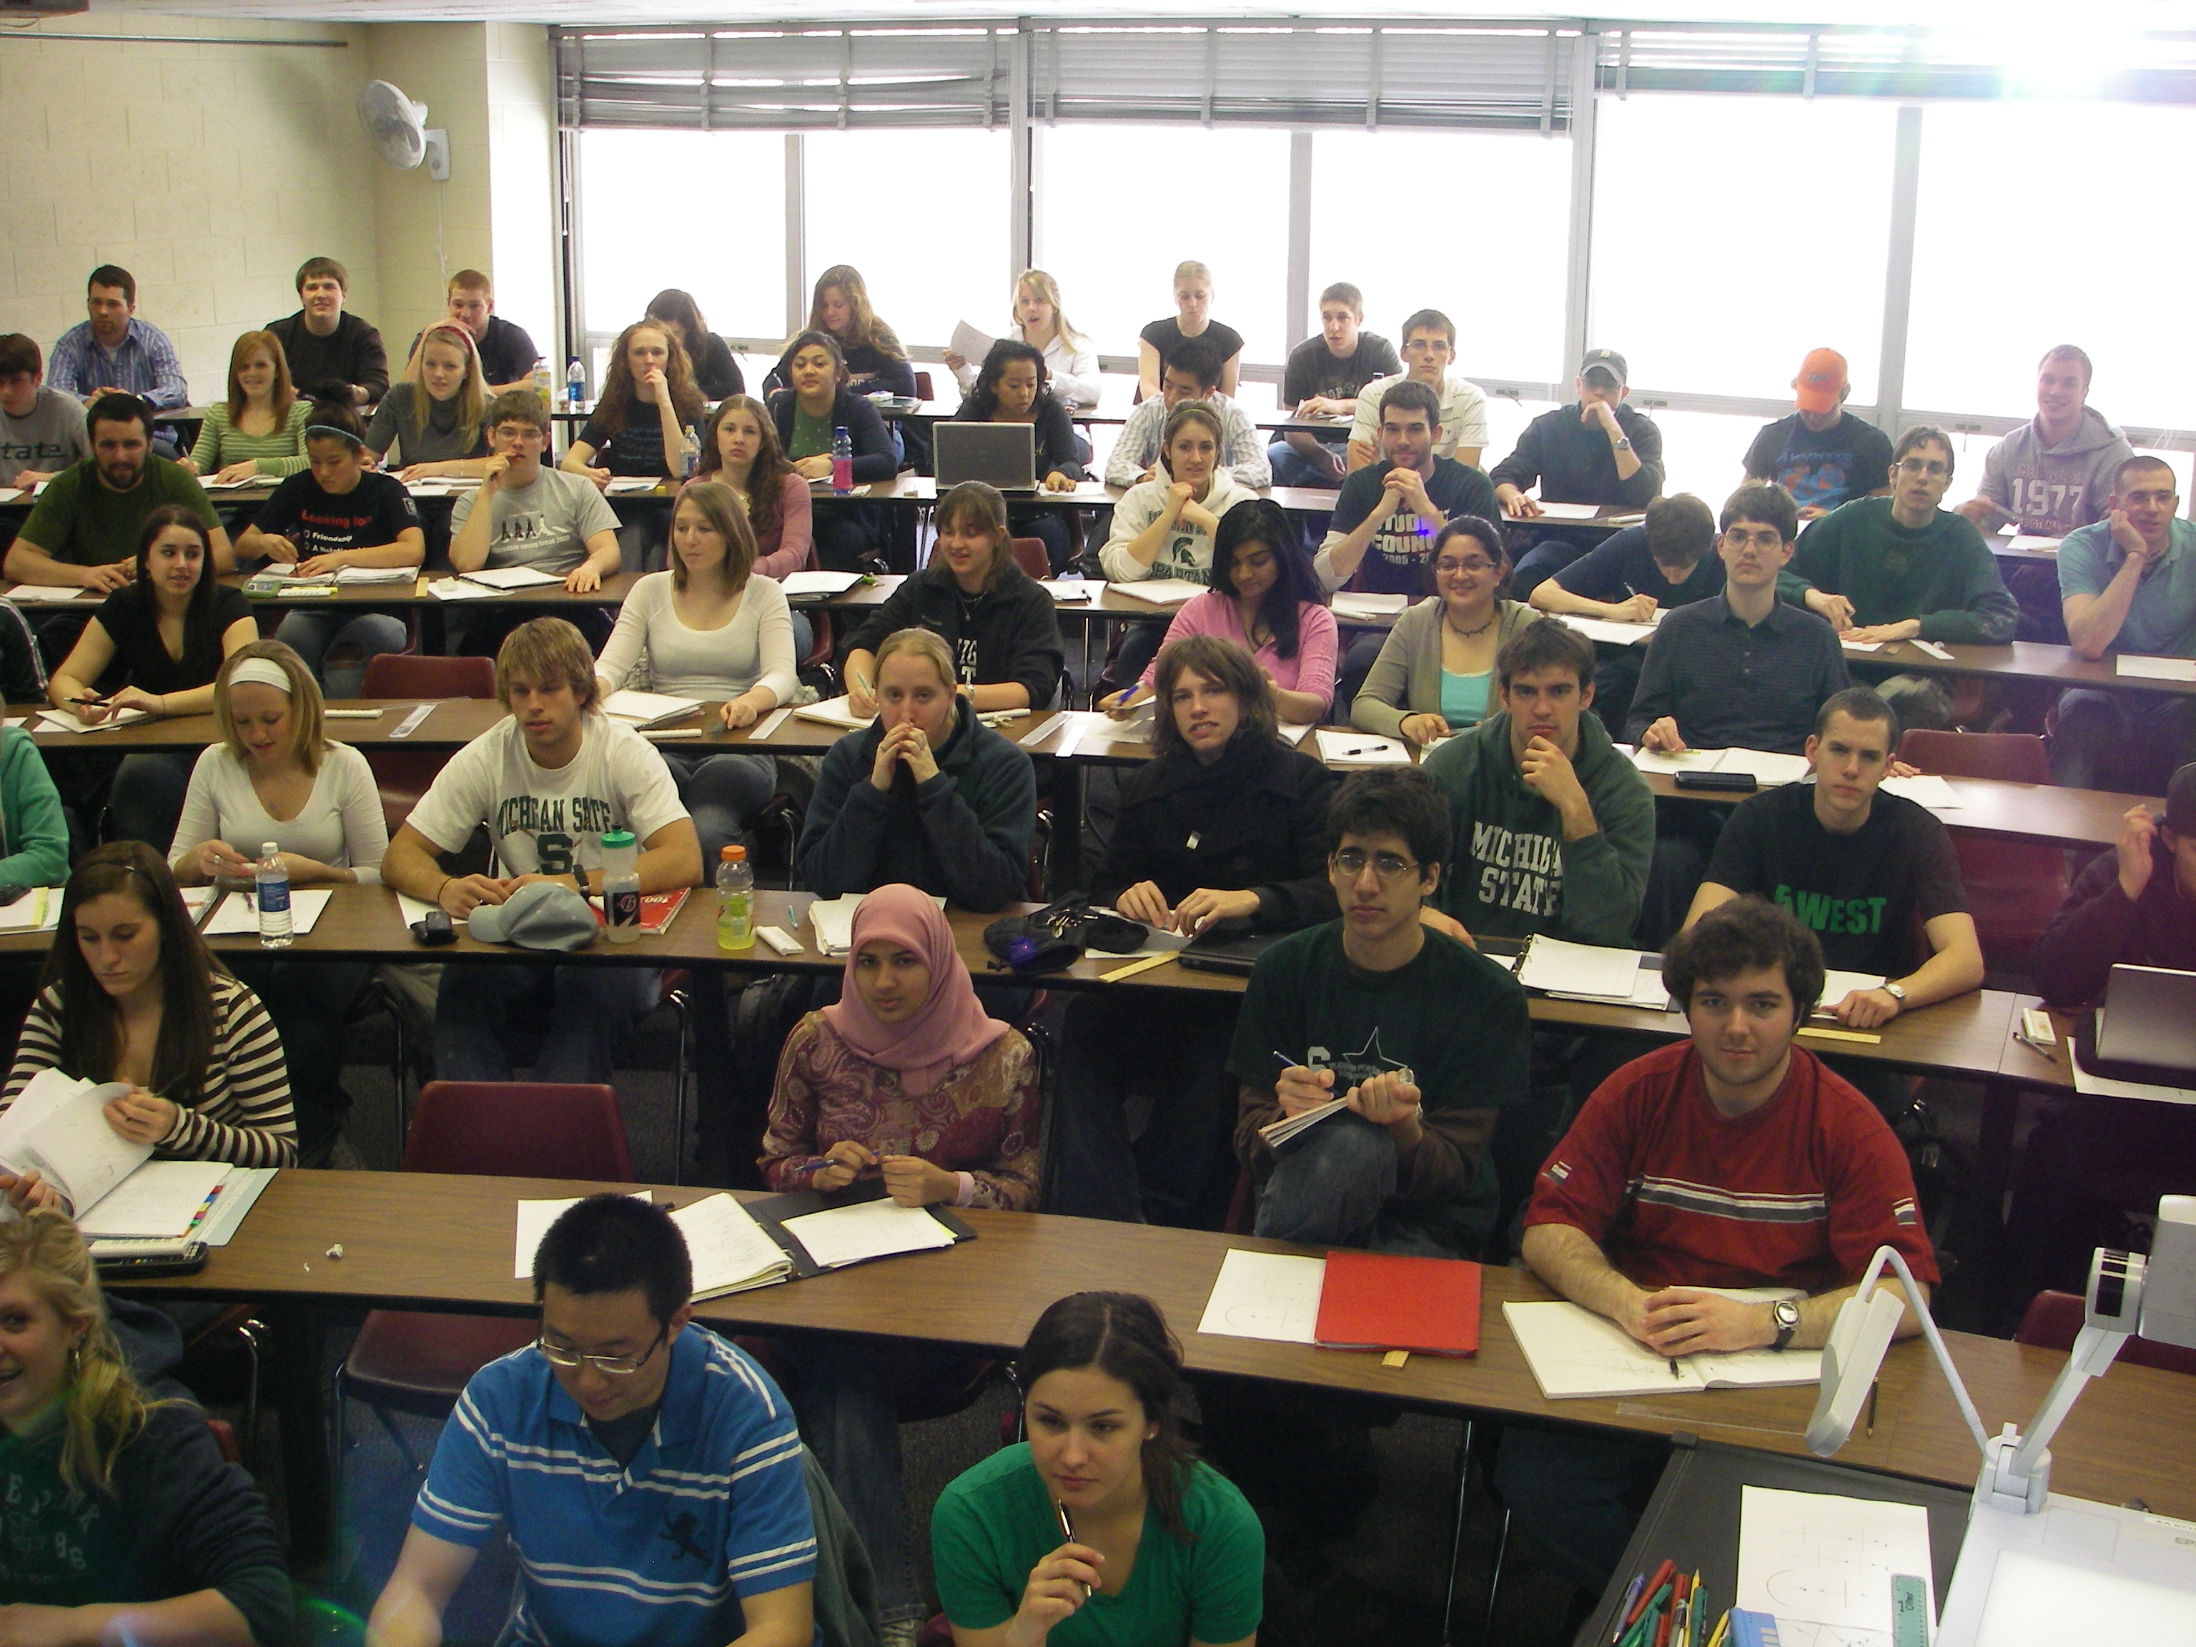
Clickers
That’s clear – no, wait …
Doesn’t he get that we don’t get it?
Yawn!
Looks like everybody but me understands this!
I wonder what’s for lunch
Sadly, too often:
Anonymous crowd in our lecture hall
We don’t know what’s going on in their heads

Slide 14
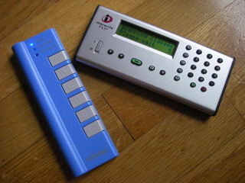
Clickers
RF devices
One per student
Students can answer questions during lecture

Slide 15
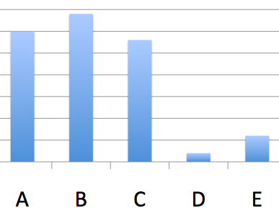
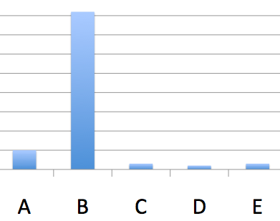
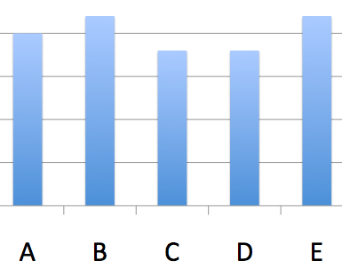
Clicker
Lecture progress depends on voting outcome
  Explain again
  Go on
  Let students discuss
  and vote again

Slide 16
Clicker
Peer-Instruction
Students can sometimes explain concepts better than us to their peers
  We have forgotten what we initially struggled with
Students learn while explaining

Slide 17
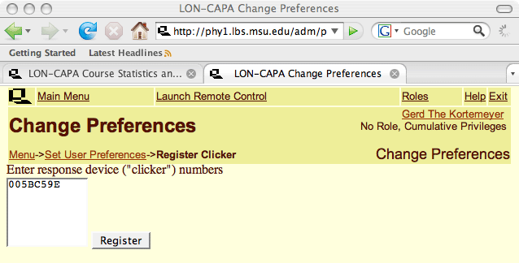
Clicker
Students register in LON-CAPA

Slide 18
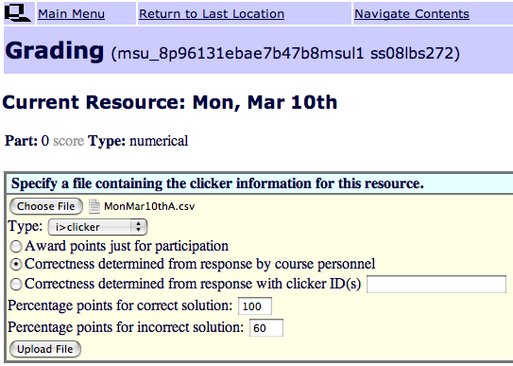
Clicker
Give credit for correct and for incorrect answers

Slide 19
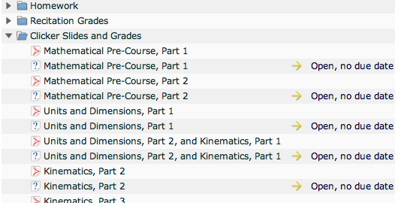
Clicker
Embedded in course, alongside slides

Slide 20
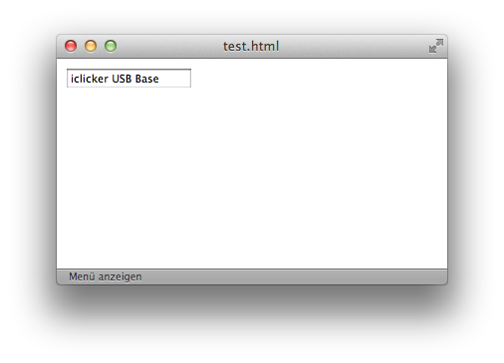
Currently under Development
Currently: uploading of session data
Work-in-progress: running session out of LON-CAPA
Questions
from shared
content
library
(more later)
Item statistics

Slide 21
Post-Class Questions
Homework
Helprooms
Exams

Slide 22
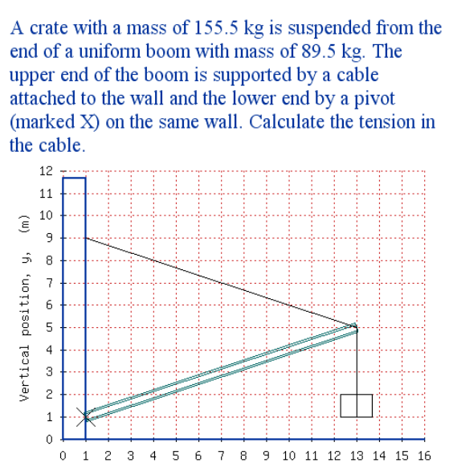
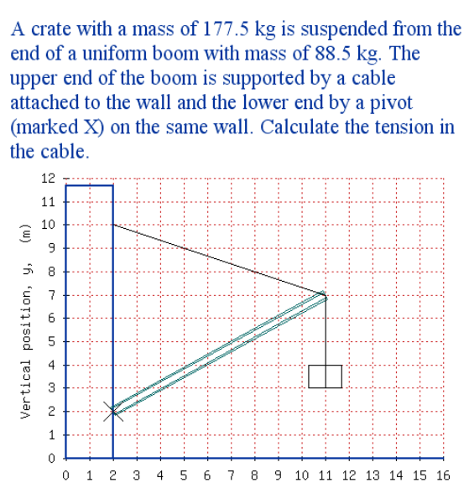
Homework
More sophisticated highly randomizing problems

Slide 23
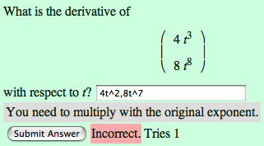
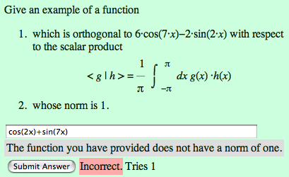
Homework
…special emphasis on math
  including support of
    LaTeX
    Maxima
    R

Slide 24
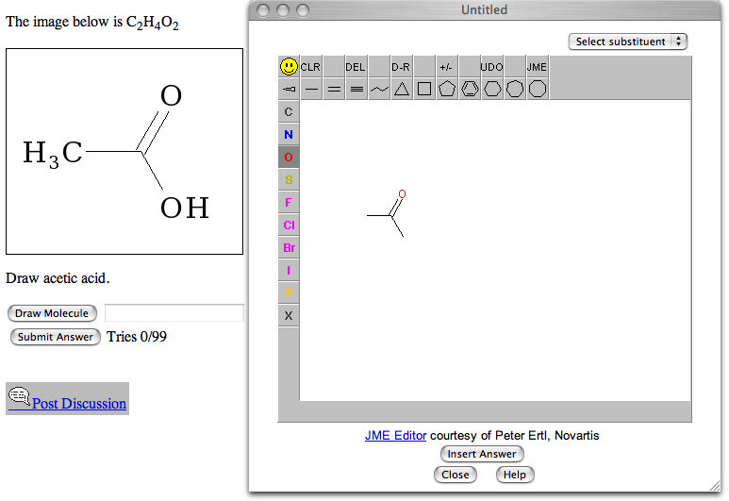
Homework
… chemistry …

Slide 25
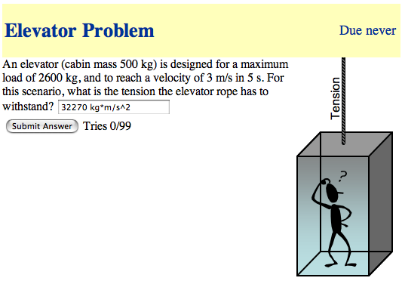
Homework
… physical units …

Slide 26
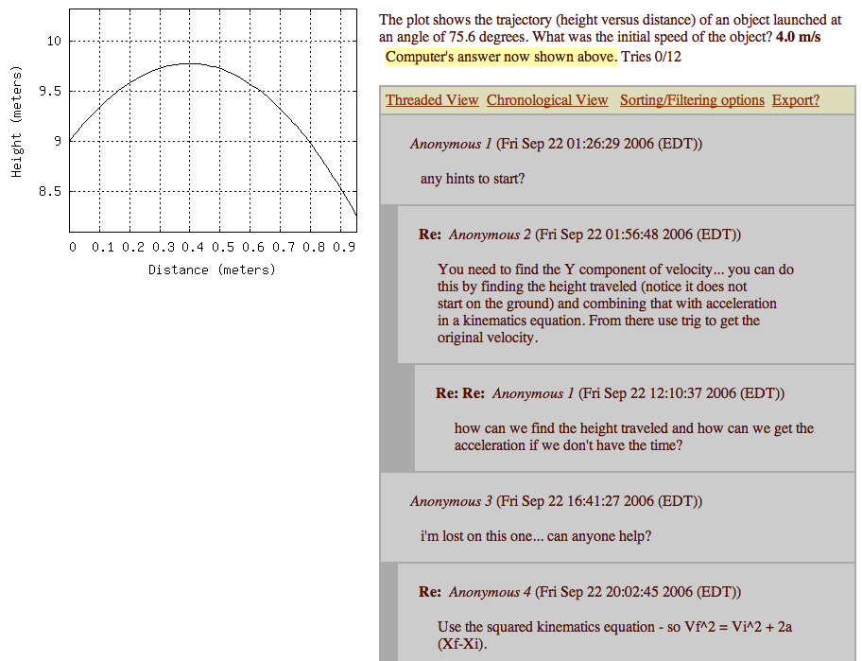
Online Discussions
Discussions
Encouraged, since all students have different versions.
Again: Peer-Instruction.

Slide 27
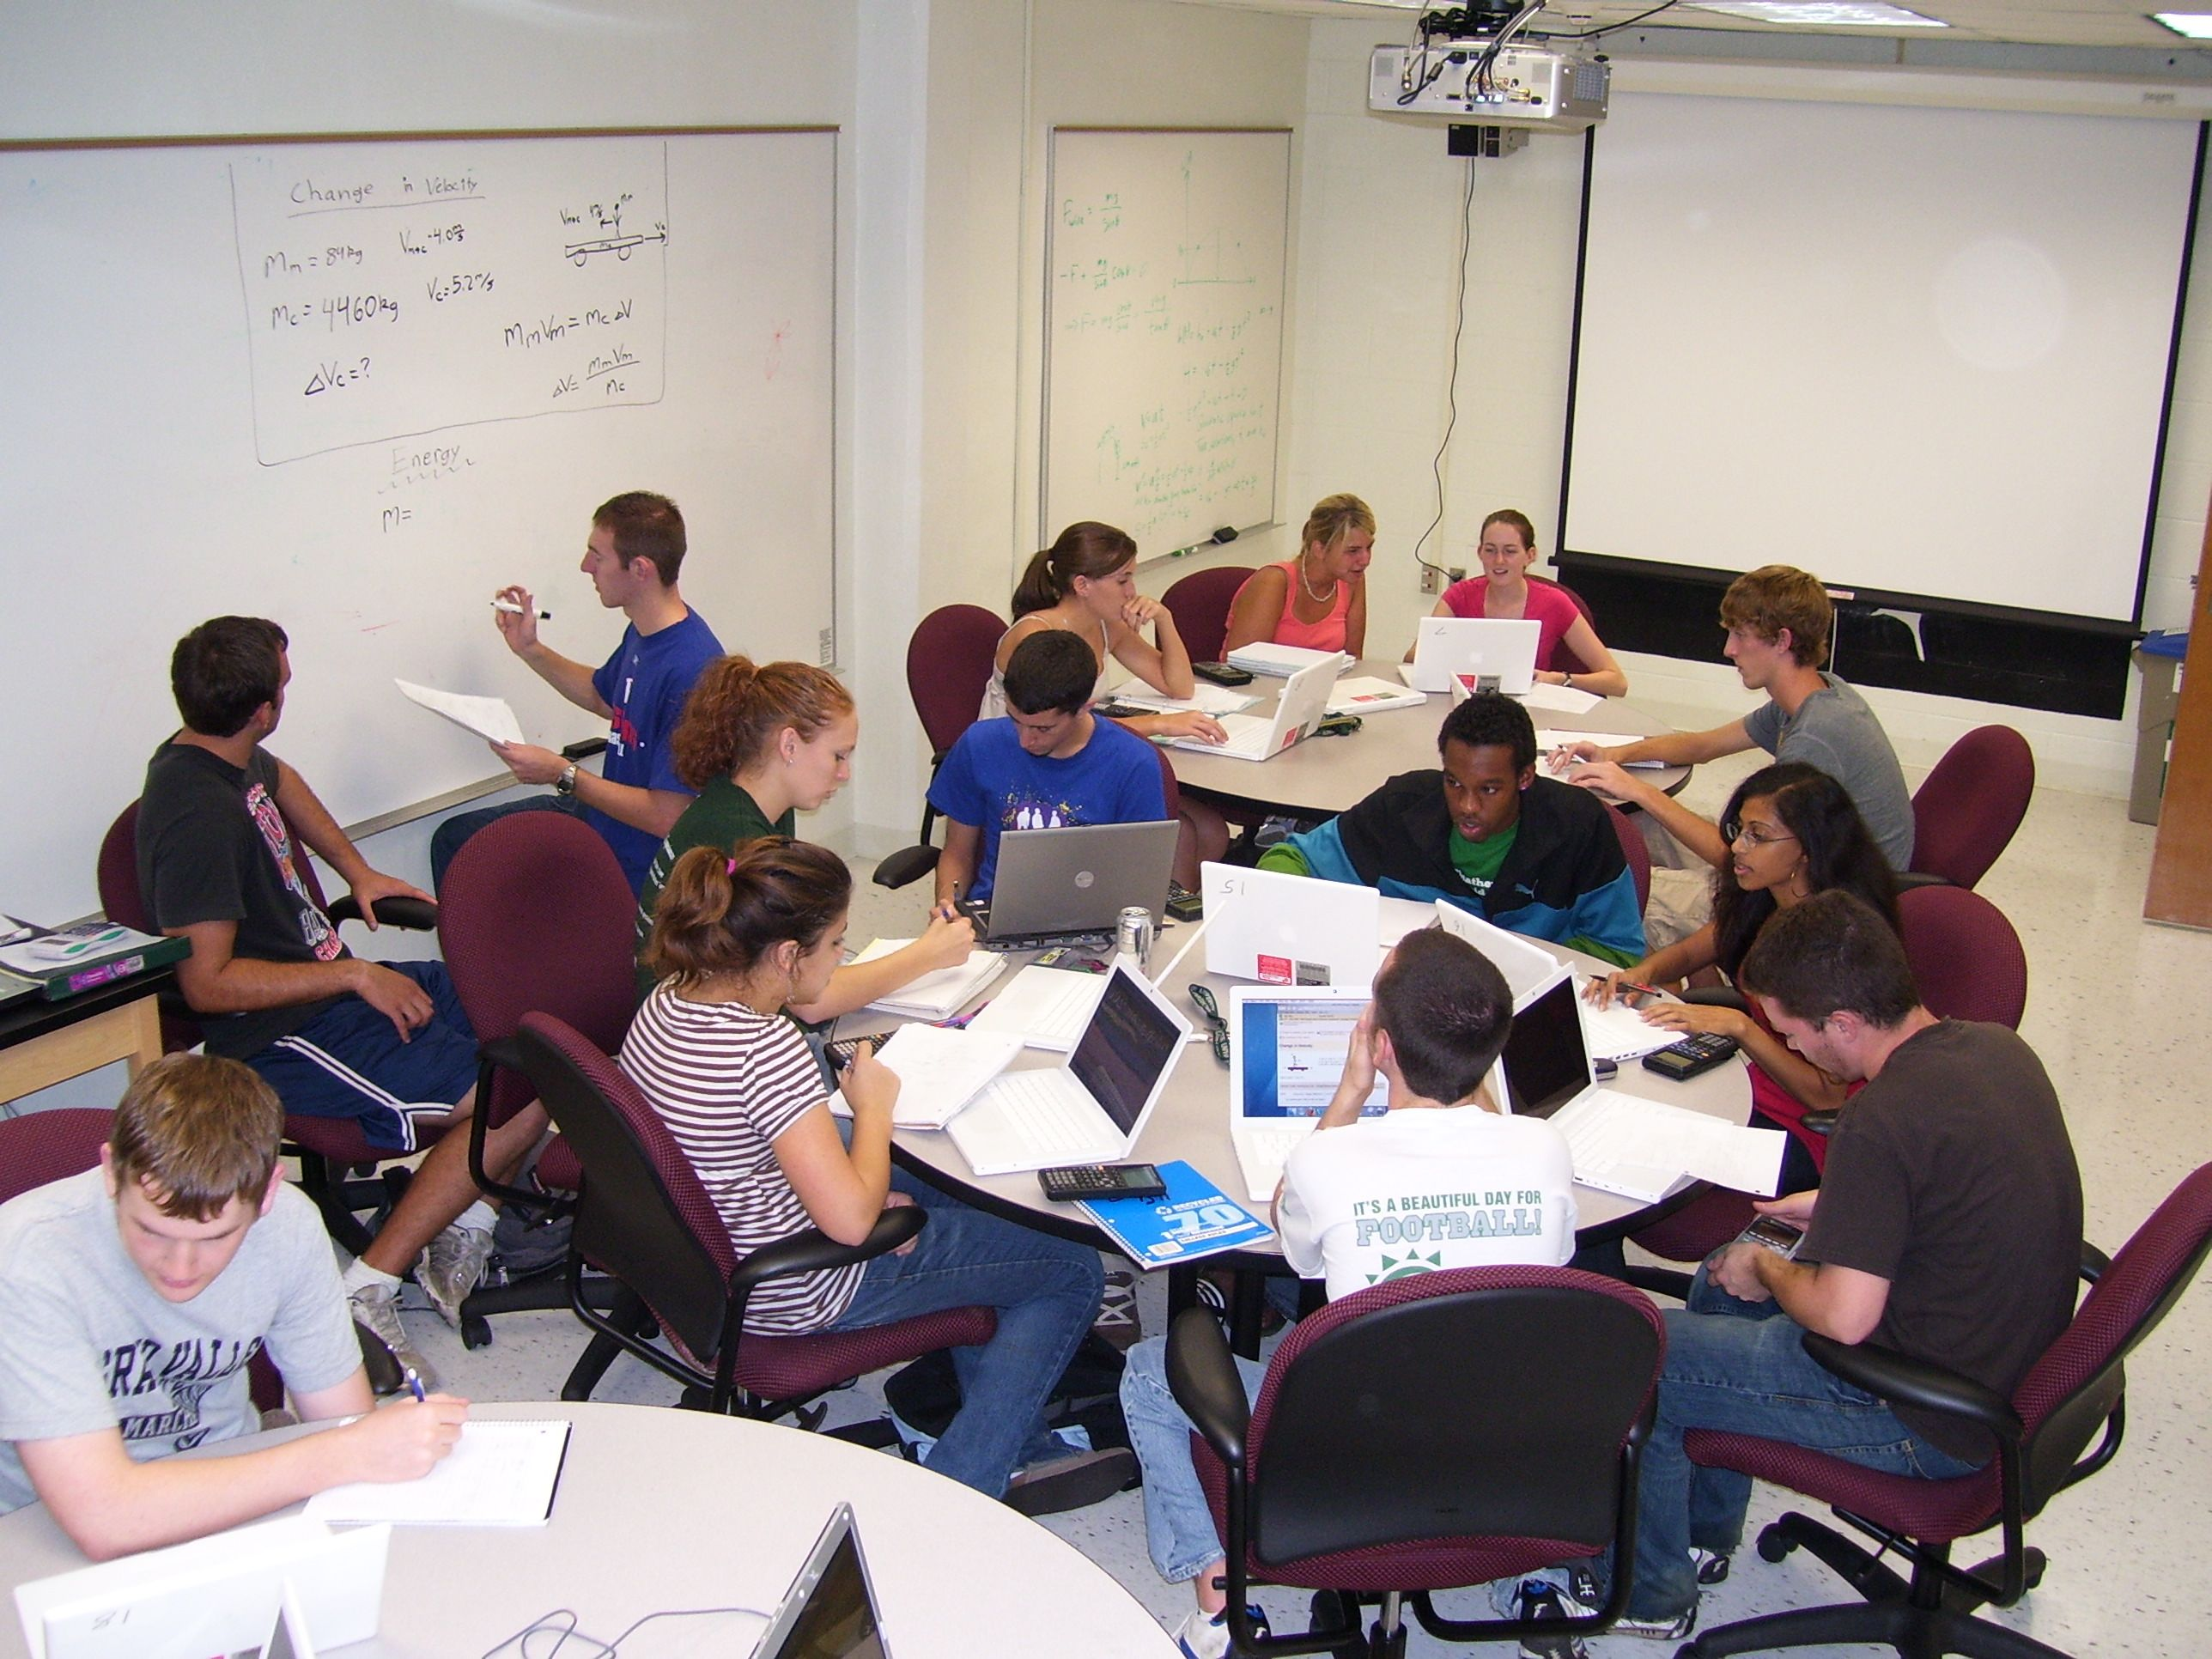
Helprooms
Staffed
with
Learning
Assistants
in the
evenings
Collaborative learning space, peer instruction

Slide 28
Exams
Problems can also be rendered for bubble sheets
Each student has a different exam

Slide 29
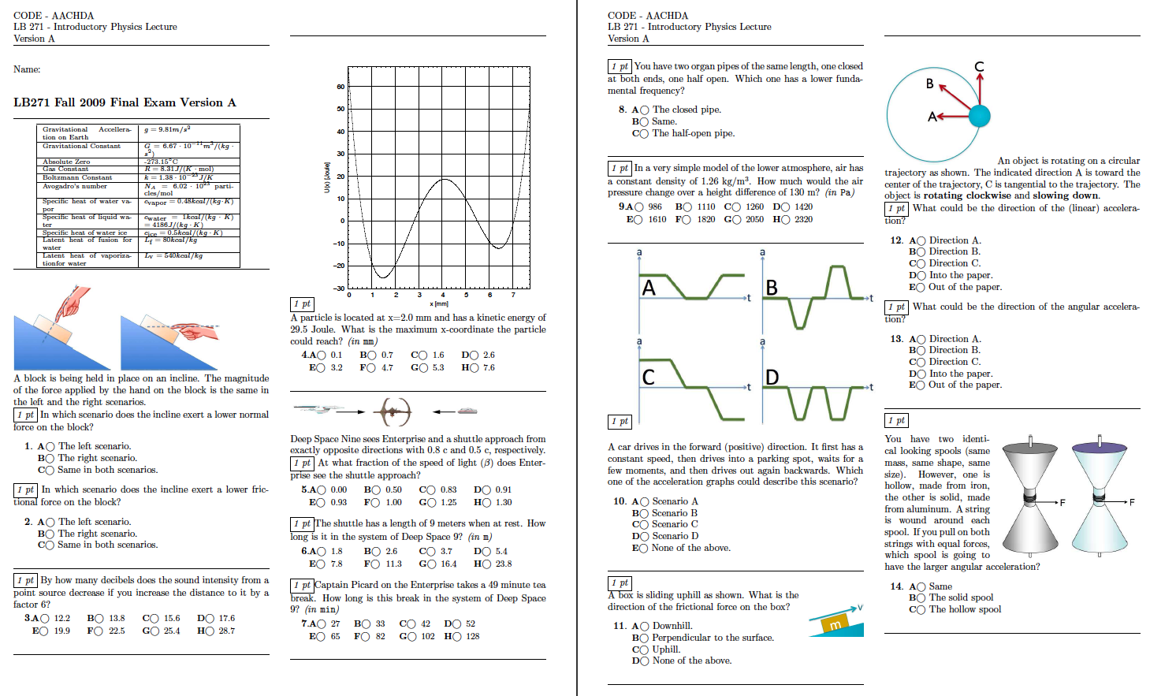
Exams

Slide 30
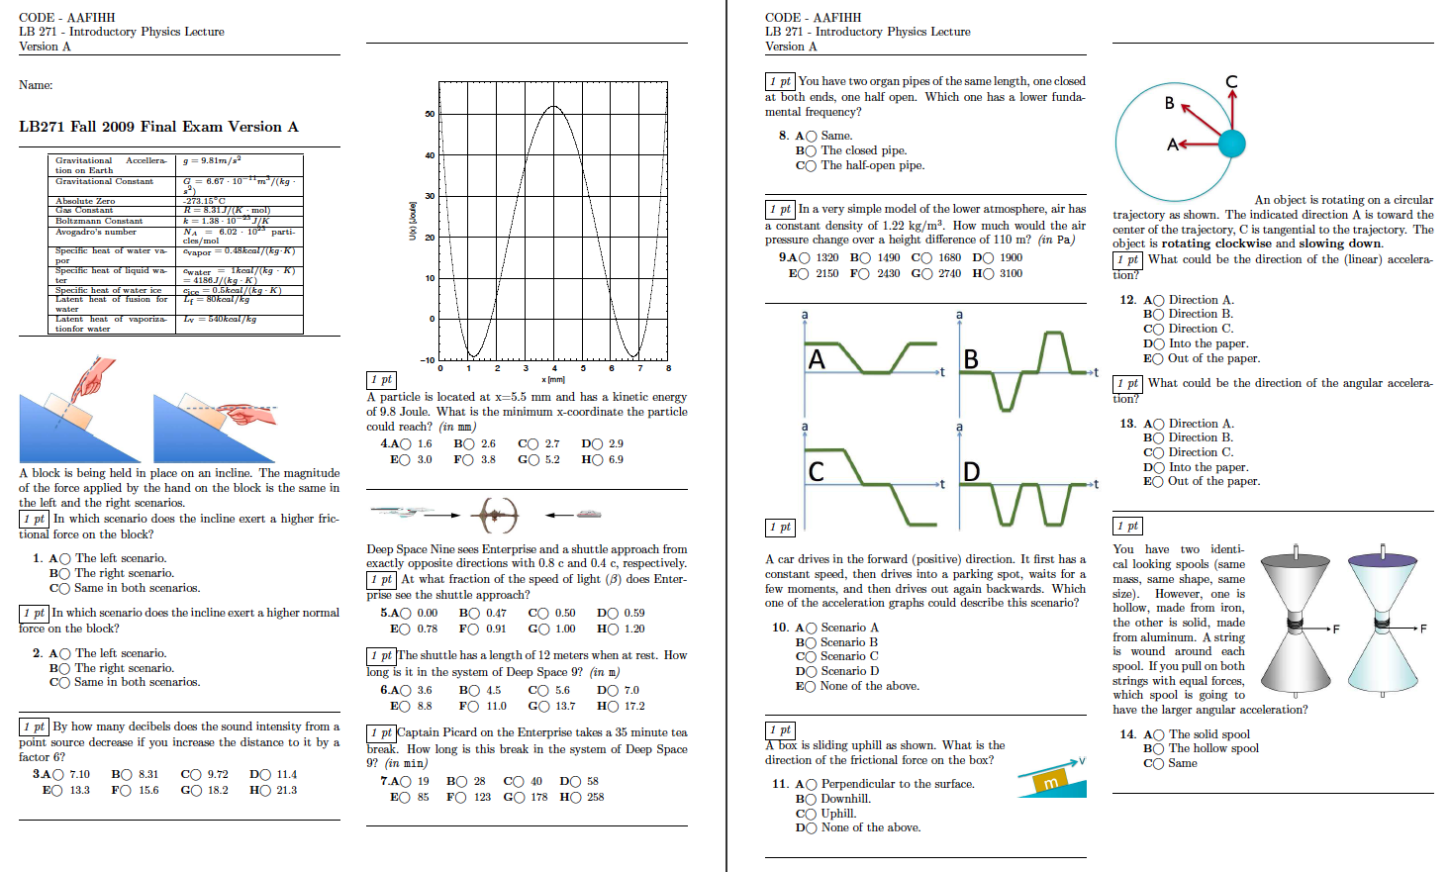
Exams

Slide 31
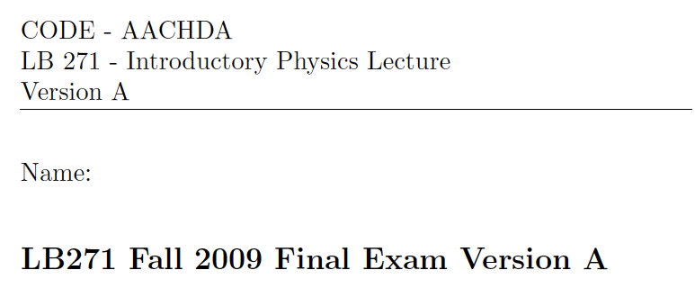
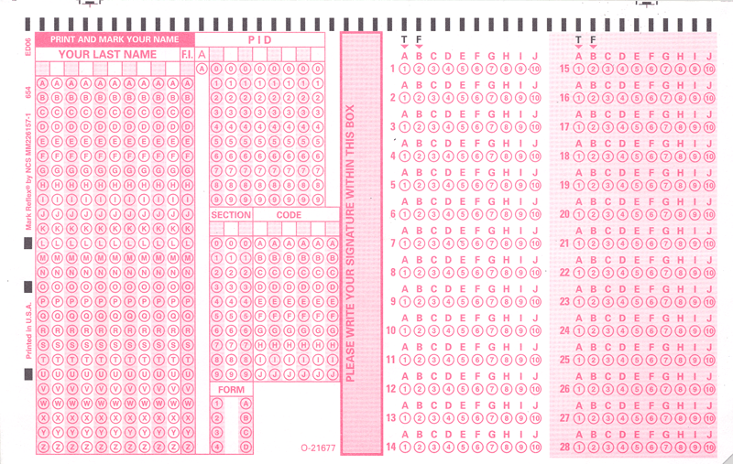
Exams

Slide 32
Before we go on …
… does this even work?

Slide 33
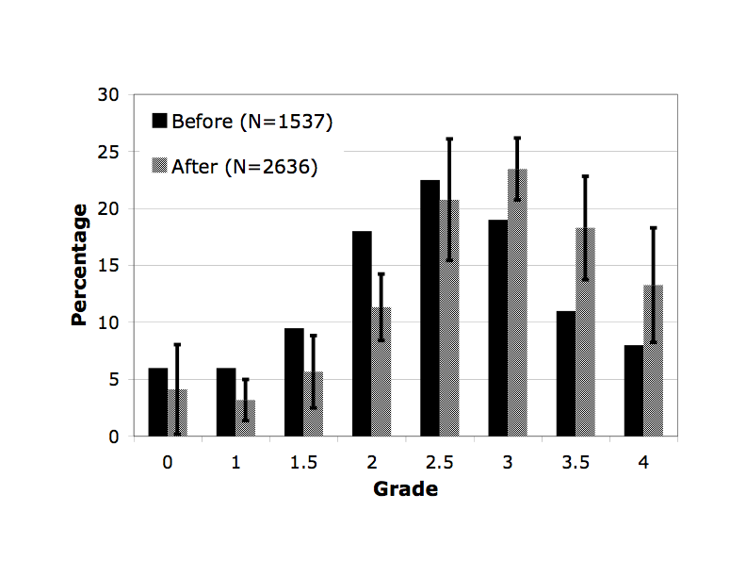
Learning Success
Intro Physics for Scientists and Engineers
Grades in years before and after online homework

Slide 34
Learning Success
Mostly helps students who are on the brink of failing the course.
Fail

Slide 35
How is this realistically possible?

Slide 36
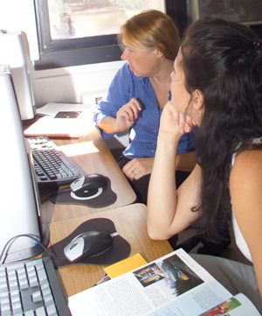
Sharing of Resources
Creating online resources is a lot of work
Doing so for use in just one course is a waste of time and effort
Many resources could be used among a number of courses and across institutions

Slide 37


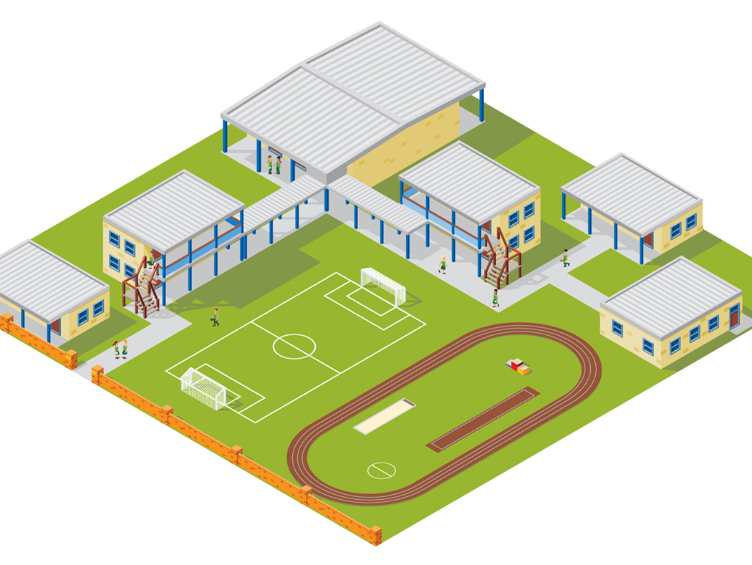



LON-CAPA Architecture
WWW
Web
Instructor
Computer
Interserver
Campus A
Campus B
WWW
Campus C
Inter-Institutional
Network of Servers Connecting Universities and Schools
Student Computer

Slide 38

LON-CAPA Architecture
Campus A
Campus B
Course Management
Course Management
Resource Assembly
Resource Assembly
Shared Cross-Institutional Resource Library

Slide 39
The LON-CAPA Community
Shared content repository with almost 450,000 resources
Almost 200,000 online homework problems

Slide 40
LON-CAPA Enrollment

Slide 41
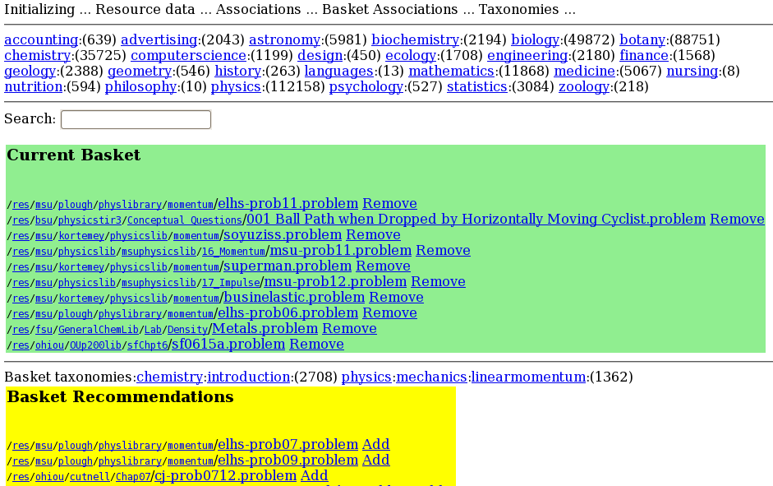
WIP: Recommender

Slide 42
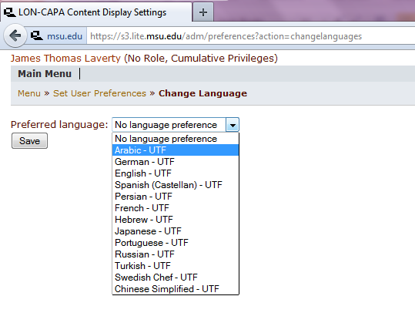
Languages

Slide 43
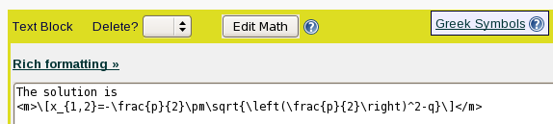

Mathematical Output
Typesetting:
LaTeX can be embedded anywhere in the material

Slide 44
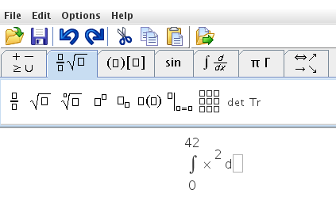
Mathematical Output
Editor for non-native LaTeX speakers

Slide 45
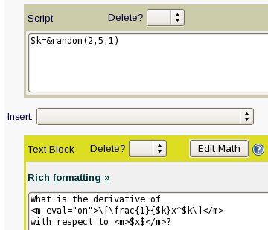


Mathematical Output
Generated on-the-fly, can vary from student to student.

Slide 46
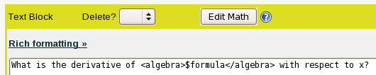

Mathematical Output
<algebra>-tag to pretty-print the output from computer algebra systems
Example: $formula=“a*x^5”

Slide 47
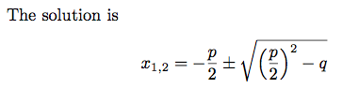
Mathematical Output
One-source, multiple target
Looks good in print
  Online:
  Print (dynamically generated PDF):

Slide 48
Mathematical Output
Dynamic Graphing
  Data-Points
  Functions
  Line-Graphics
Internally uses
GNUplot

Slide 49
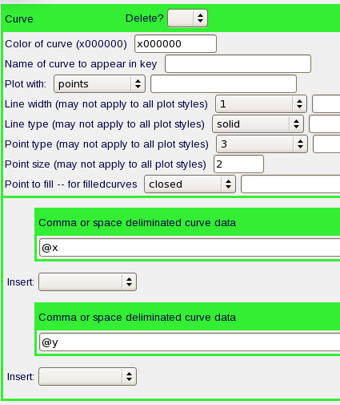
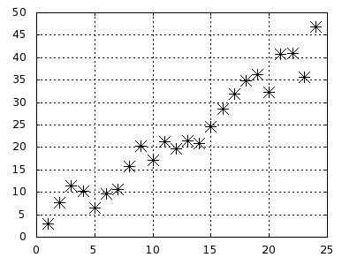
Mathematical Output
Data points

Slide 50
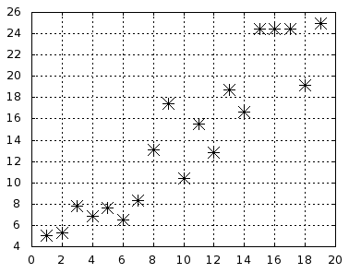
Mathematical Output
Data points

Slide 51
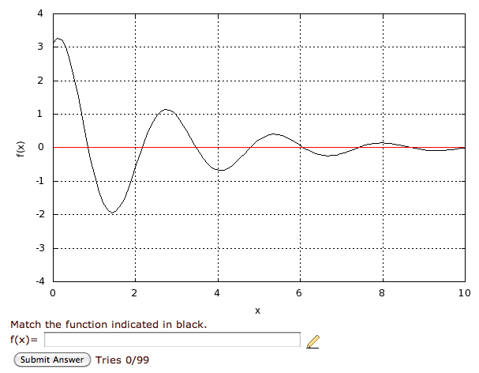
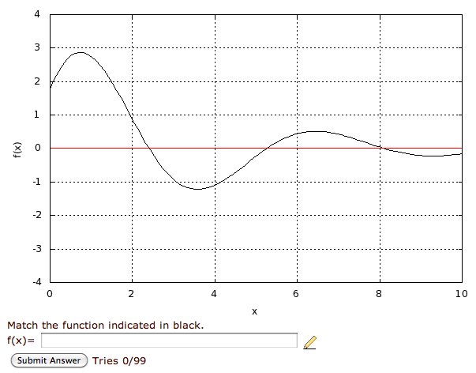
Mathematical Output
Functions

Slide 52
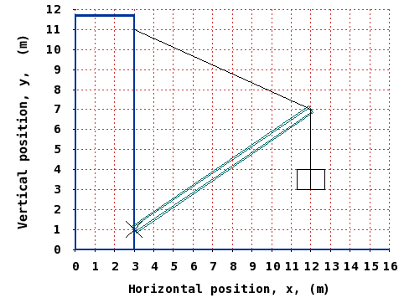
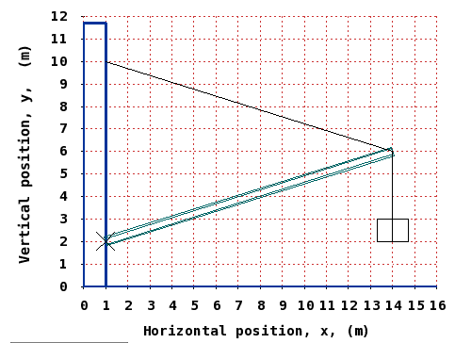
Mathematical Output
Line graphics

Slide 53



Generating Mathematics Problems
LON-CAPA problems include
  Perl Scripting Environment
  MAXIMA Computer Algebra System
  R Statistics Package
Problems not just randomized,
but randomly generated with desired properties

Slide 54
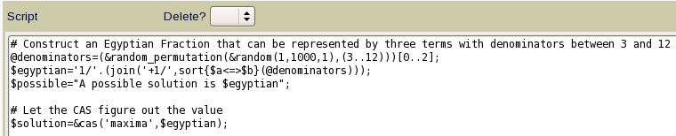
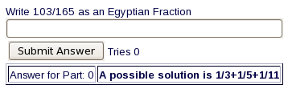
Generating Mathematics Problems
Direct calls to MAXIMA:
$result=&cas(‘maxima’,$expression);
Simple example: use computer algebra system to calculate a reduced fraction

Slide 55
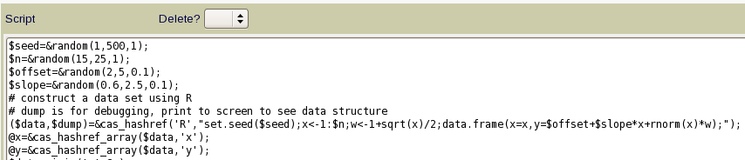
Generating Mathematics Problems
Direct calls to R:
$result=&cas(‘R’,$expression);
$results=&cas_hashref(‘R’,$expression);
Example: generate a distribution with certain properties:

Slide 56
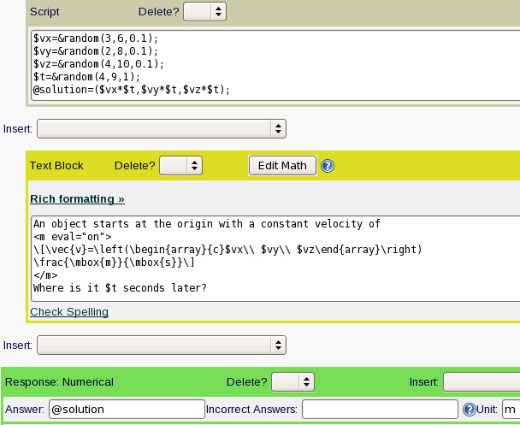
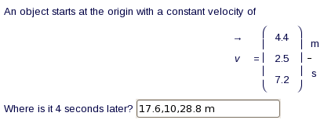
Mathematics Input
Simplest input: numerical

Slide 57
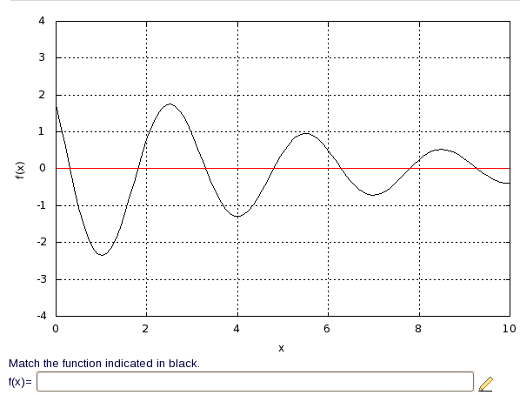
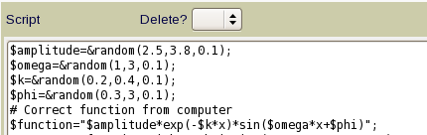


Mathematics Input
Sampling – approximate function

Slide 58


Mathematics Input
Symbolically: exactly one exact answer (but equivalent forms)

Slide 59

Mathematical Input
Checking properties
  Using R:

Slide 60


Mathematical Input
Checking properties
  Using MAXIMA:

Slide 61



Mathematical Input
Checking properties
  Using Perl and MAXIMA:

Slide 62

Mathematical Input
Math editor for students

Slide 63

Mathematical Input
Graphical input
using GeoGebra

Slide 64

Mathematical Input
Rulesets
Function
First Derivative
Second Derivative
Integral
Symbolic, computed, or hard-coded ranges

Slide 65

Mathematical Input
(This will be in the next version of LON-CAPA)
Free Body Diagrams using GeoGebra
Concept Maps
Programming Diagrams
Etc.

Slide 66

Mathematical Input
Rules
What the object is (or is not) attached to.
Specify Length and Direction of a Vector

Slide 67
Thank You
Now it’s time to play with it!
http://relate.mit.edu/physicscourse

