Slide 1
LON-CAPA
Mathematical Functionality
Gerd Kortemeyer
Lyman Briggs College
February 2011

Slide 2
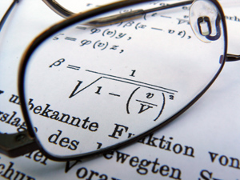
LON-CAPA Math Functionality
Today’s Session:
somewhat
specialized topic
Goal:
demonstrate how mathematical assessment is integrated into the
LON-CAPA course management functionality

Slide 3
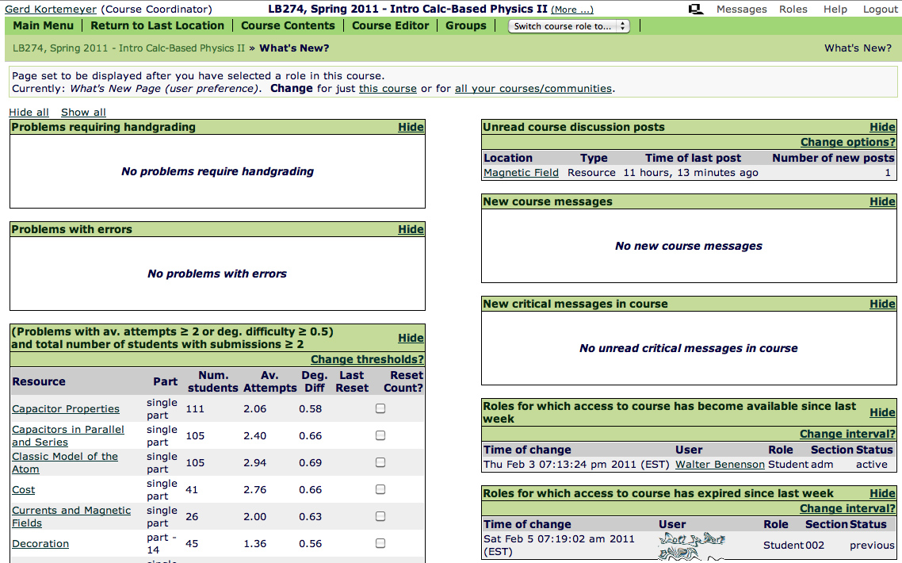
LON-CAPA Course Management
Full featured course management system
Discussions
Drop boxes
Statistics
Messaging
MSU integration

Slide 4
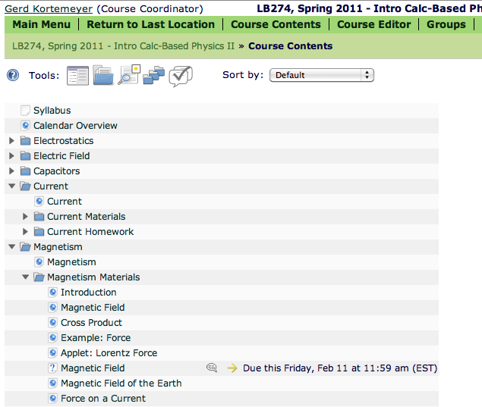
LON-CAPA Course Management
Structured Content
Embedded Assessment
Contextual Discussions
Time Management

Slide 5
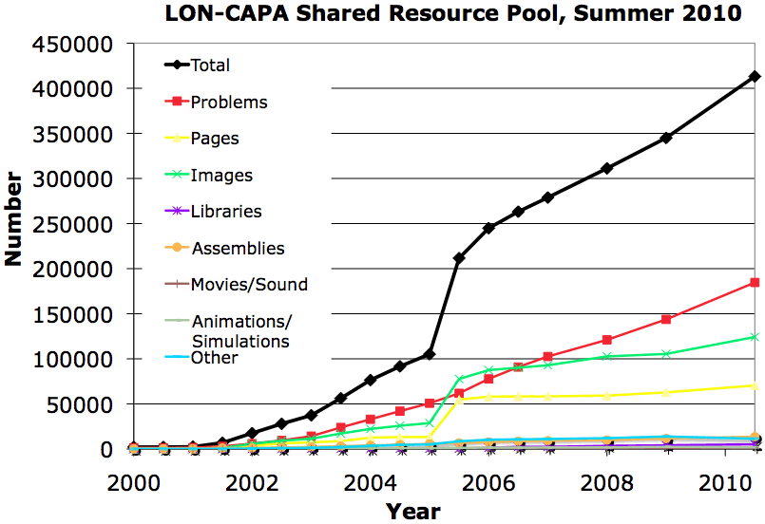
LON-CAPA Course Management
Shared Learning Content Management

Slide 6
Particular Strength: Assessment
Randomized problems: different
  numbers
  formulas
  graphs
  images
  options
  …
for each student.
Student can collaborate without “cheating”
Randomized exams

Slide 7
LON-CAPA Mathematics
Mathematics Output:
  typesetting
  graphing
Generating Mathematics Problems:
  symbolic math functionality
  statistics packages
Mathematics Input:
  numerical
  formula evaluation
    sampling
    symbolically
    checking for properties
  graphical input
  bubble sheets
  clickers
in
The grader is

Slide 8
WARNING
Today’s presentation is going to show some very specialized functionality.
Because you can does not mean you have to.

Slide 9
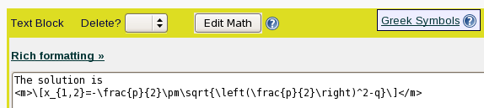

Mathematical Output
Typesetting:
LaTeX can be embedded anywhere in the material

Slide 10
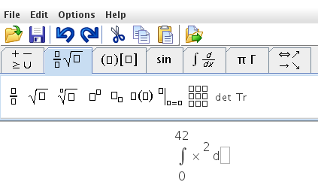
Mathematical Output
Editor for non-native LaTeX speakers

Slide 11
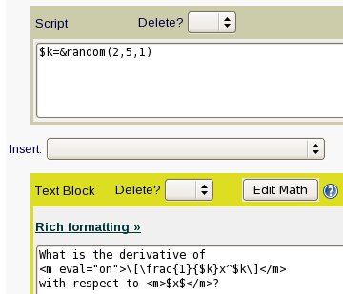


Mathematical Output
Generated on-the-fly, can vary from student to student.

Slide 12
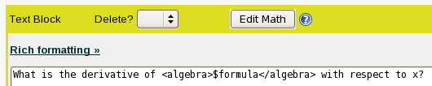

Mathematical Output
<algebra>-tag to pretty-print the output from computer algebra systems
Example: $formula=“a*x^5”

Slide 13
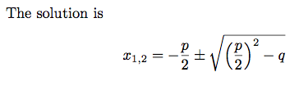
Mathematical Output
One-source, multiple target
Looks good in print
  Online:
  Print (dynamically generated PDF):

Slide 14
Mathematical Output
Dynamic Graphing
  Data-Points
  Functions
  Line-Graphics
Internally uses
GNUplot

Slide 15
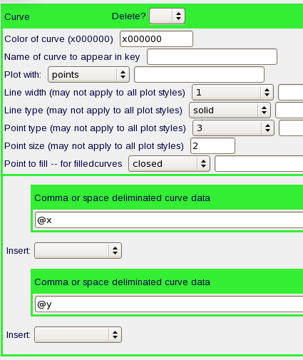
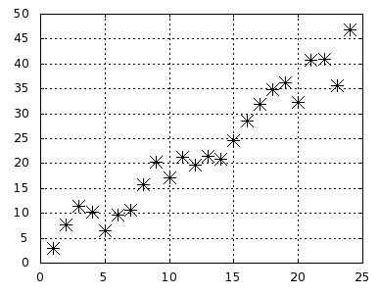
Mathematical Output
Data points

Slide 16
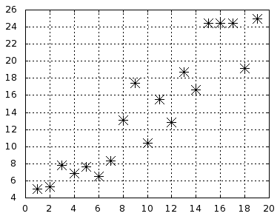
Mathematical Output
Data points

Slide 17
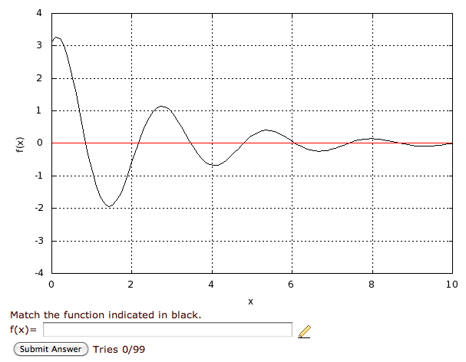
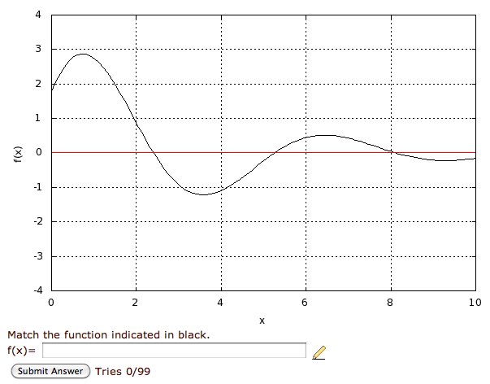
Mathematical Output
Functions

Slide 18
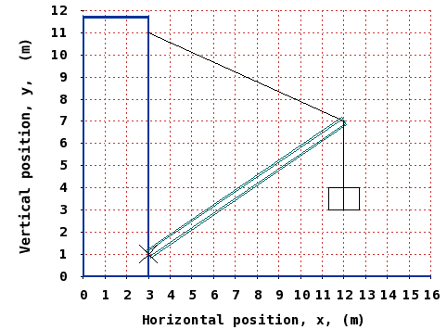
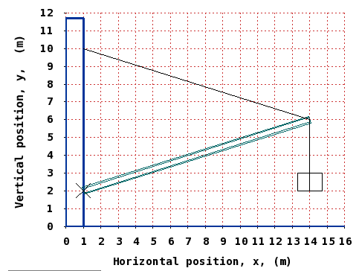
Mathematical Output
Line graphics

Slide 19



Generating Mathematics Problems
LON-CAPA problems include
  Perl Scripting Environment
  MAXIMA Computer Algebra System
  R Statistics Package
Problems not just randomized,
but randomly generated with desired properties

Slide 20
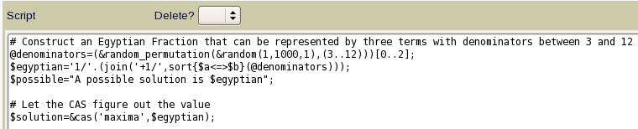
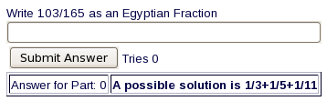
Generating Mathematics Problems
Direct calls to MAXIMA:
$result=&cas(‘maxima’,$expression);
Simple example: use computer algebra system to calculate a reduced fraction

Slide 21
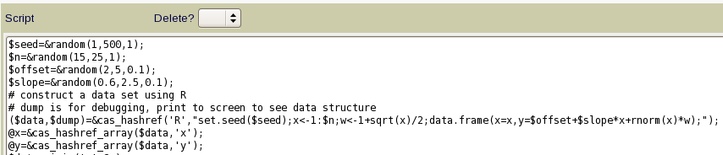
Generating Mathematics Problems
Direct calls to R:
$result=&cas(‘R’,$expression);
$results=&cas_hashref(‘R’,$expression);
Example: generate a distribution with certain properties:

Slide 22
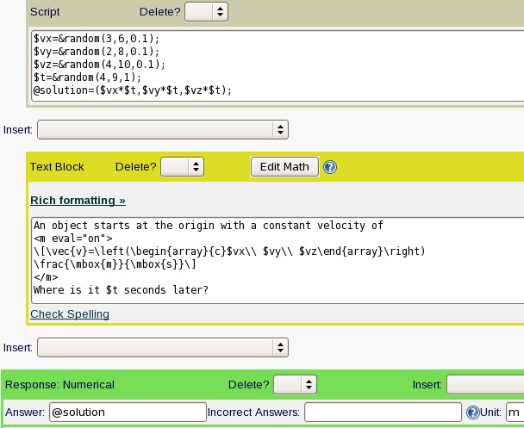
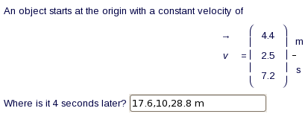
Mathematics Input
Simplest input: numerical

Slide 23
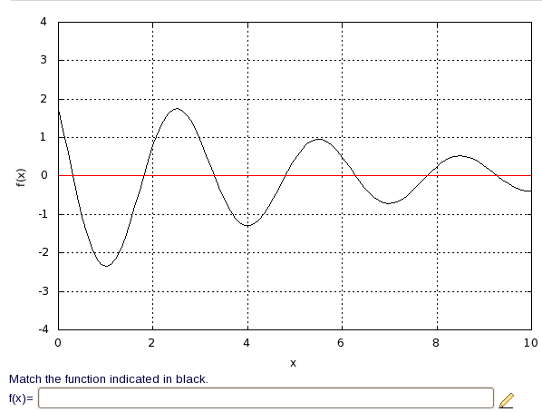
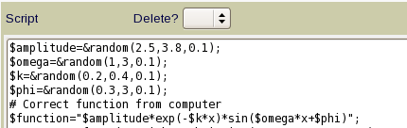


Mathematics Input
Sampling – approximate function

Slide 24
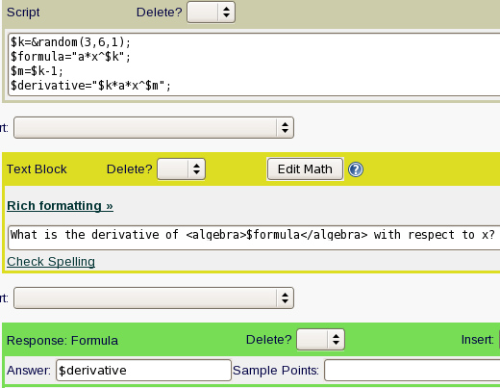

Mathematics Input
Symbolically: exactly one exact answer (but equivalent forms)

Slide 25
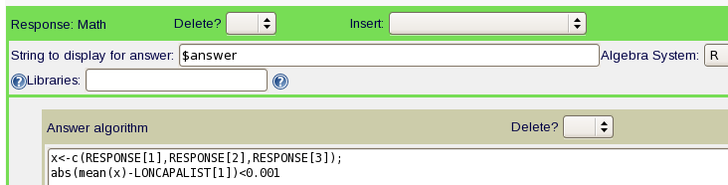
Mathematical Input
Checking properties
  Using R:

Slide 26
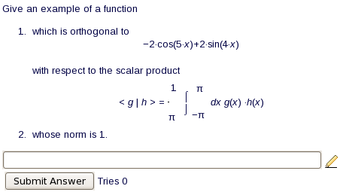

Mathematical Input
Checking properties
  Using MAXIMA:

Slide 27

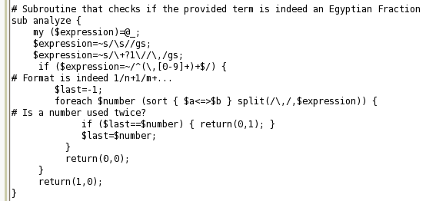
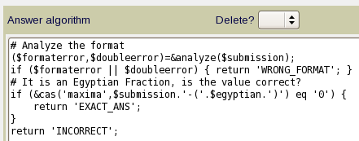
Mathematical Input
Checking properties
  Using Perl and MAXIMA:

Slide 28
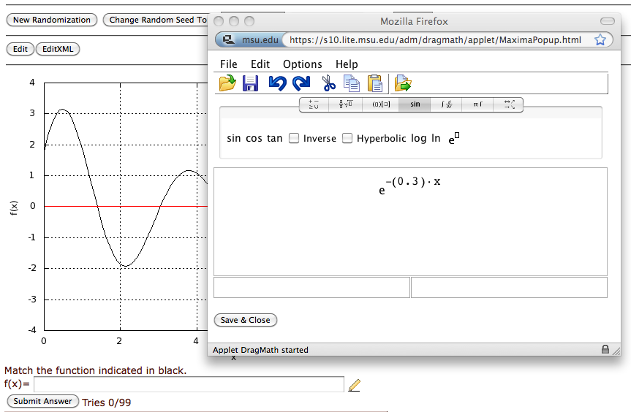
Mathematical Input
Math editor for students

Slide 29
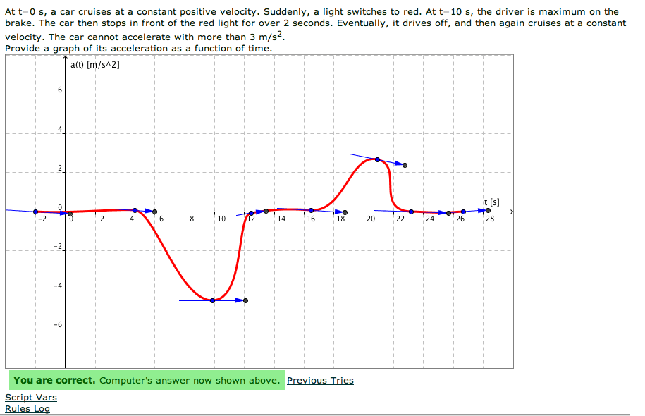
Mathematical Input
Graphical input
using Geogebra

Slide 30
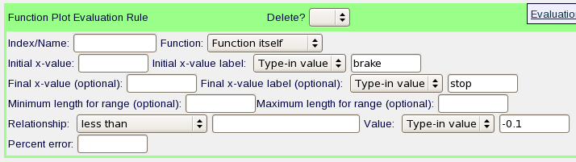
Mathematical Input
Rulesets
Function
First Derivative
Second Derivative
Integral
Symbolic, computed, or hard-coded ranges

Slide 31
Mathematical Input
Problems can also be rendered for bubble sheets
Every student gets a different version

Slide 32
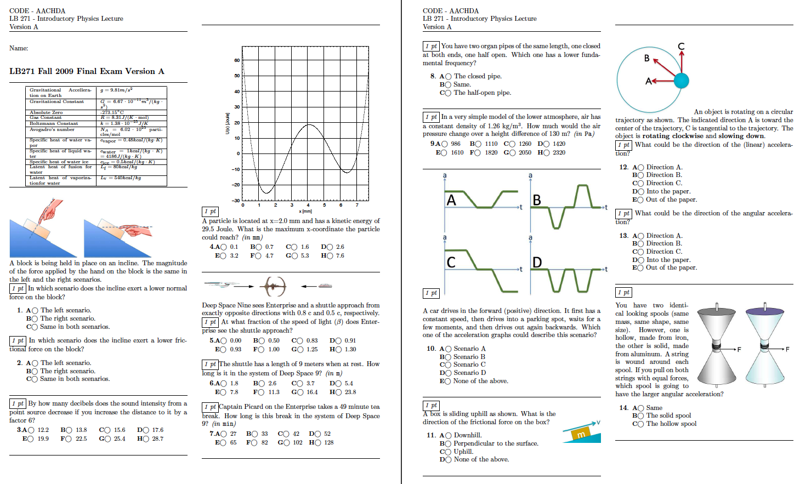
Mathematical Input

Slide 33
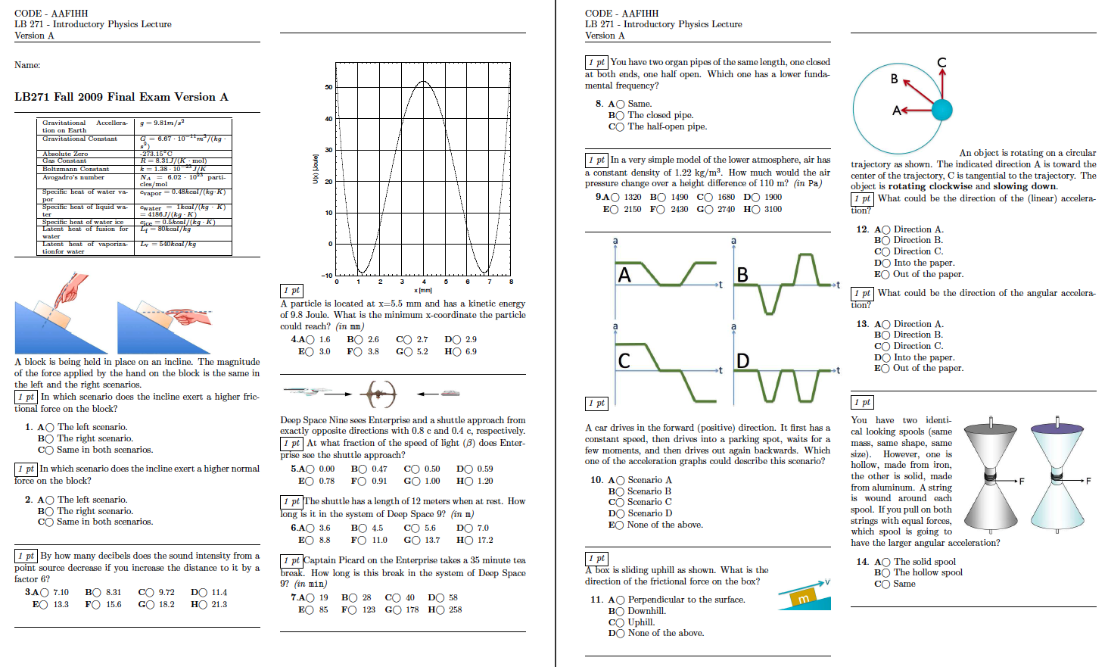
Mathematical Input

Slide 34
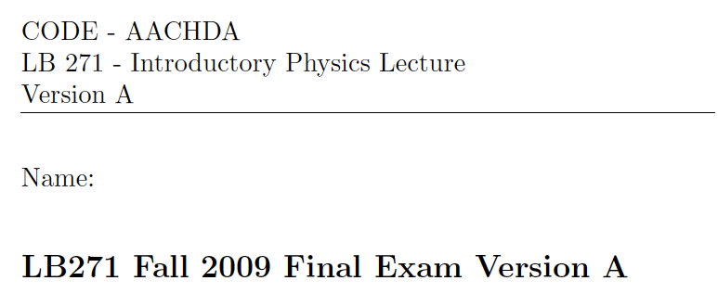
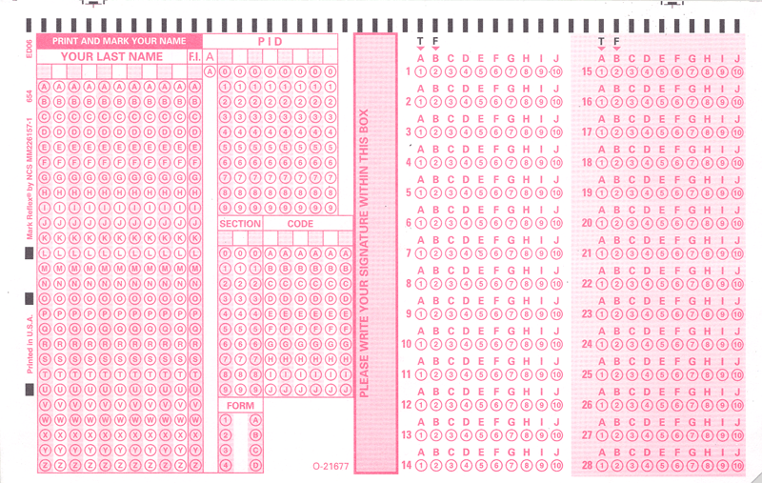
Mathematical Input

Slide 35
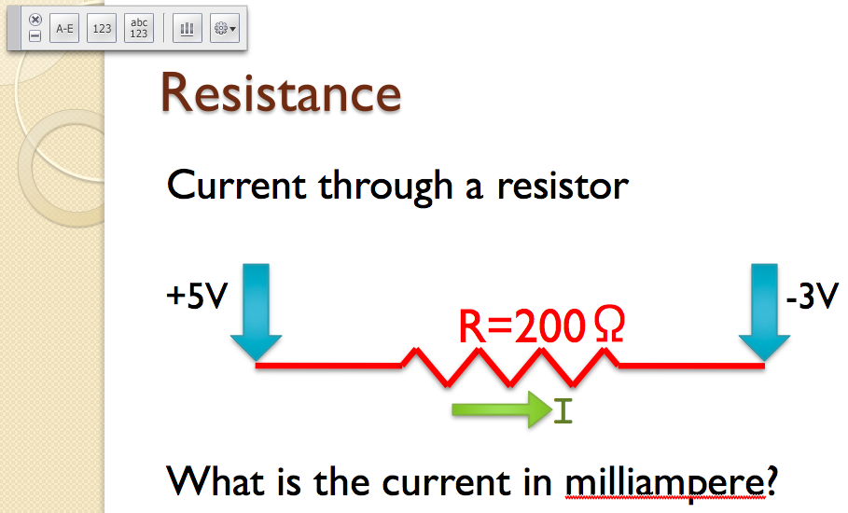
Mathematical Input
Numerical Clicker
in Lecture

Slide 36
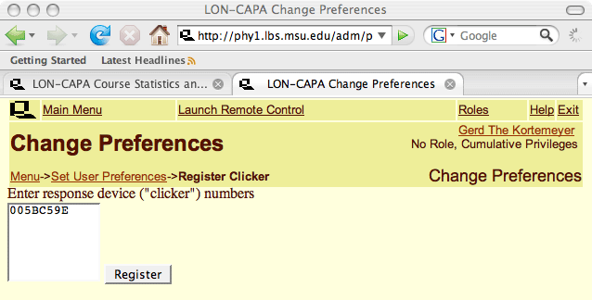
Mathematical Input
LON-CAPA can evaluate clicker data after lecture

Slide 37
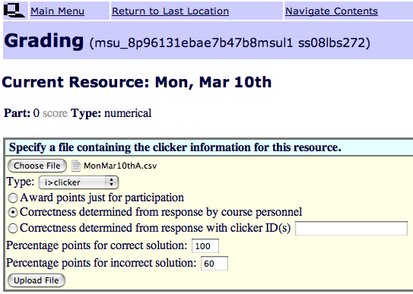
Mathematical Input

Slide 38
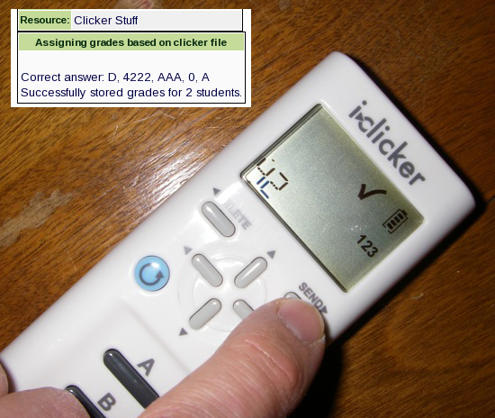
Mathematical Input
i>clicker2 integrated in LON-CAPA

Slide 39
Interested?
Faculty Seminars
May 10-11, 2011
Can give departmental colloquia
Work one-on-one
LON-CAPA Conference
Virginia Commonwealth University May 19-21, 2011
LON-CAPA Workshop
MSU, late June

Slide 40
Thank You
Gerd Kortemeyer
Lyman Briggs College
and
Division of Science and Mathematics Education
korte@lite.msu.edu
http://www.lon-capa.org/

